Slide 1

An Interactive Dashboard to Estimate
Environmental Externalities of
Generative AI Queries
AI Footprint
Calculator
COL8381 — Responsible AI
IIT Delhi
Arindam Rajiv Dongre
2025MCS2092
Pratik Chaudhari
2025MCS2096

Slide 2
The Problem
80–90%
1–1.3%
Most
of ML cloud compute
is inference, not training
of global electricity
by data centers in 2022
users are unaware of the
footprint of their queries
AWS, 2019
IEA, 2023
GPTFootprint, 2025

Slide 3

Why This Matters
Energy at Scale
A single ChatGPT query uses 10× more energy than a Google search. At 700M+ queries/day, this is substantial.
Sources: Luccioni et al. (2024), Li et al. (2023), IEA Electricity 2023, GPTFootprint (2025)

Slide 4
Why This Matters
Energy at Scale
A single ChatGPT query uses 10× more energy than a Google search. At 700M+ queries/day, this is substantial.
Carbon Blind Spot
Model cards report training carbon but never inference carbon — yet inference dominates lifetime emissions.
Sources: Luccioni et al. (2024), Li et al. (2023), IEA Electricity 2023, GPTFootprint (2025)

Slide 5

Why This Matters
Energy at Scale
A single ChatGPT query uses 10× more energy than a Google search. At 700M+ queries/day, this is substantial.
Carbon Blind Spot
Model cards report training carbon but never inference carbon — yet inference dominates lifetime emissions.
Hidden Water Cost
GPT-3 consumes ~500mL of water for every 10–50 responses. Global AI water withdrawal could reach 6.6B m³ by 2027.
Sources: Luccioni et al. (2024), Li et al. (2023), IEA Electricity 2023, GPTFootprint (2025)

Slide 6
Our Approach — The Formula
Eserver = αm × βℓ × γh
Efacility = Eserver × PUE
Cq = Efacility × Igrid
Wq = Eserver × ρs1 + Efacility × ρs2
α_m
Base energy/query
β_ℓ
Prompt-length scaling
γ_h
Hardware factor
Measured (CodeCarbon)
Our regression (R²=0.817)
PUE
Data center overhead
I_grid
Grid carbon intensity
ρ_s1 / ρ_s2
Water efficiency
Li et al. (2023)
Dodge et al. (2022)
Li et al. (2023)

Slide 7
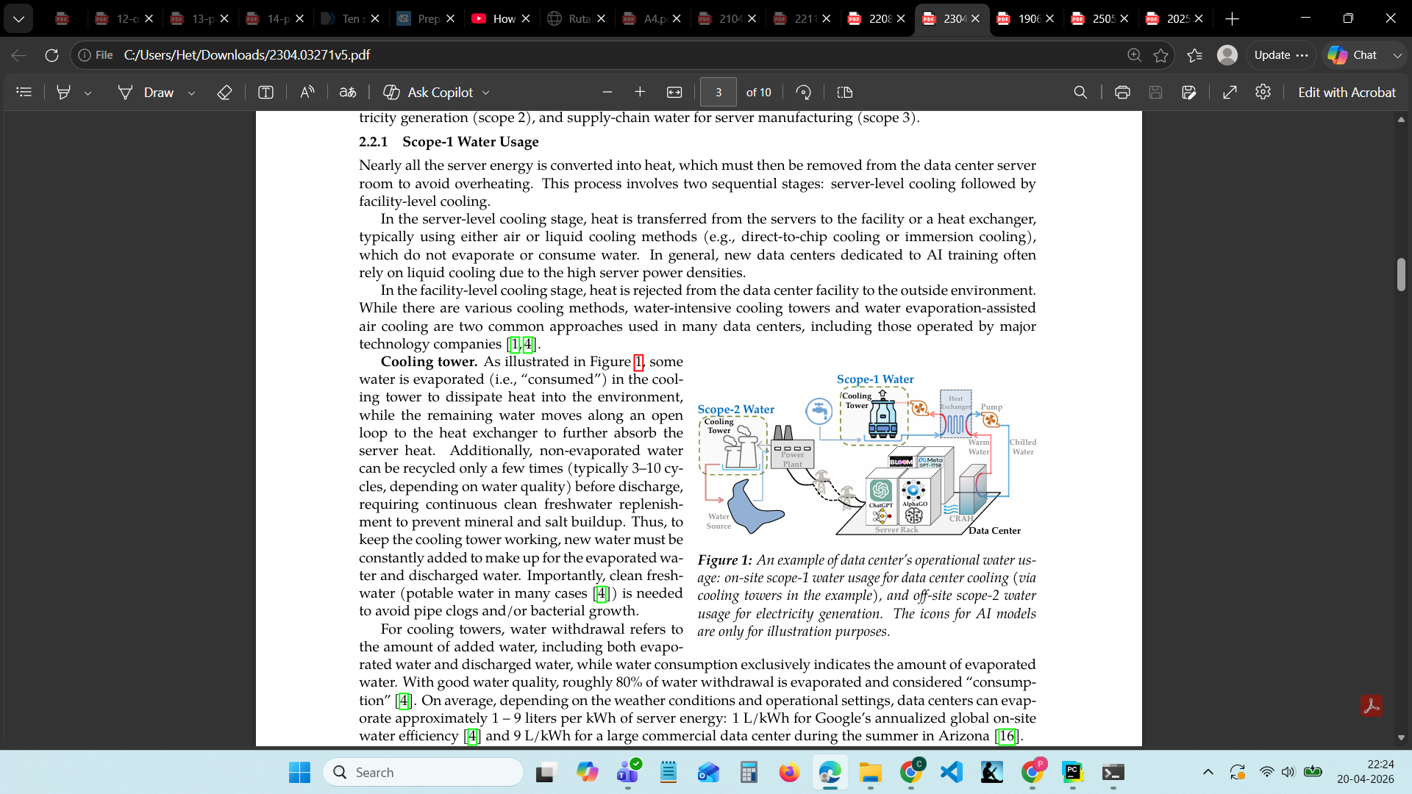
What is ps1 and ps2?
​
Source: Luccioni et al. (2024).
​

Slide 8
Empirical Calibration
Process
Key Results
1. Built 120 prompts across 4 tasks × 5 length levels
2. Ran on Flan-T5-base + Qwen-0.5B (Kaggle T4)
3. 3 repeats per prompt with CodeCarbon tracking
4. Fit GradientBoostingRegressor on features
5. Extracted α_m per model, β_ℓ heuristics from coefficients
Metric | Flan-T5 | Qwen
α_m (kWh) | 6.4e-5 | 1.83e-4
Ref output | 104 tokens | 154.8 tokens
Type | Seq2Seq | Decoder-only
R² = 0.817
GBR on held-out data
Qwen 2.86× costlier than Flan-T5
Validates Luccioni: decoder > seq2seq

Slide 9

Our Novel Feature
Prompt-Level Attribution via Ablation
Example Attribution
"in detail"
+0.0142 g CO₂e
"multiple examples"
+0.0089 g CO₂e
"step by step"
+0.0067 g CO₂e
Suggestion: Add "briefly"
→ ~50% savings
What no existing tool does:
GPTFootprint & EcoLogits treat every query the same — flat per-query average.
Our tool inspects the prompt itself:
1. Predicts output length from keywords (β_ℓ)
2. Ablates each phrase → measures carbon delta
3. Shows which words cost the most
4. Suggests rewrites to reduce footprint

Slide 10
Main Results
Key Findings
70× difference between shortest and longest prompts
2.86× decoder-only costs vs seq2seq (same task)
β_ℓ is the dominant cost driver, not model size alone
Adding 'briefly' cuts footprint ~50%
Carbon per query by prompt type (Qwen 0.5B, India grid)

Slide 11
Case Studies
🎓
💼
🔬
Student
Professional
Researcher
40/day · Medium LLM · India
250/day · Large LLM · US
500/day · Large + Image · US
⚡ Energy
0.156 kWh/day
⚡ Energy
3.75 kWh/day
⚡ Energy
6.0 kWh/day
🌿 Carbon
3.15 kg CO₂/yr
🌿 Carbon
18.1 kg CO₂/yr
🌿 Carbon
28.9 kg CO₂/yr
💧 Water
17.1 L/month
💧 Water
82 L/month
💧 Water
131 L/month
All estimates use uncertainty ranges (min / avg / max). Values shown are averages.

Slide 12
How We Differ
Feature | EcoLogits | GPTFootprint | Ours
Energy + Carbon | ✓ | ✓ | ✓
Water footprint | ✗ | ✗ | ✓
Prompt analysis | ✗ | ✗ | ✓
Phrase attribution | ✗ | ✗ | ✓
Rewrite suggestions | ✗ | ✗ | ✓
Measured coefficients | Regression | Flat avg | CodeCarbon
No setup required | Needs API key | Browser ext. | ✓
Our core differentiator: we analyze the prompt content itself, not just count queries.

Slide 13

Limitations & Future Directions
Limitations
Future Directions
Calibrated on 2 small models only (250M, 500M)
β_ℓ uses keyword heuristics, not the full regression
Hardware pinned to T4 (γ_h = 1.0)
Embodied carbon out of scope
No real-time API measurement
Calibrate on larger models (7B, 70B) with A100s
Deploy full regression model via Flask backend
Add Monte Carlo uncertainty (replace min/max)
Browser extension for real-time ChatGPT tracking
User study on awareness → behavior change
Thank you!

